Slide 1
Frontline Health Workers
Presented to Global Mission Health Conference 2013 by Doug Fountain

Slide 2
Frontline workers - 50 years
Long established in China, Brazil, Bangladesh, India, Ethiopia,
Frontline workers
Vital to local health systems because based in/come from community.
Include community health workers, nurses, midwives, pharmacists and others who primarily work at the community level.
Help families and individuals connect to health services, and in some cases are capable of providing lifesaving assistance.

Slide 3
Where and how are these people identified and trained?
What is the emerging role for medical missions in this area?
Objectives
Identify emerging trends, opportunities and requirements for training of front line health workers
Describe how those trends relate to the challenges faced in implementing qualified frontline workers in underserved areas
Apply experience from medical missions to help overcome those challenges.

Slide 4
What (Who) are Frontline Health Workers
Frontline health workers provide services where most needed, especially rural/remote areas.
Include community health workers, midwives, local pharmacists, nurses and some doctors who serve community clinics. http://frontlinehealthworkers.org
Community members who serve as frontline health care professionals. Generally work with the underserved and are indigenous to community in which they work: ethnically, linguistically, socioeconomically, and experientially. (Love, et al 1997)

Slide 5
What do they do?
Common:
Provide care when not enough prof. health workers available
Connect families and communities to the health system
Provide many life saving interventions
May also:
Deliver immunizations,
Treat common infections,
Help families identify conditions needing higher levels of care
Deliver babies, give pre- and post-natal care,
Advise on nutrition and malnutrition
Valuable in diarrhea, pneumonia, malaria, HIV, TB
Increasingly: NCDs like diabetes and heart disease

Slide 6
Primary care pyramid
More cost, more complexity, more training as move up, but more frequency as move down.
District Hospital
1st level health
Community
Home
Emergency, referral, surgery
Basic primary care, common illnesses and injuries, MCH, reproductive health, Essential drugs, Health promotion, nutrition, environment
Food, Water, Sanitation, Shelter
Immunization, Vit A, ORT, screening referral, surveillance, skilled birth…
Breast feeding, food availability
Water source, storage, quality
Sanitation - latrine, hygiene
Shelter, goods, prevent injury

Slide 7
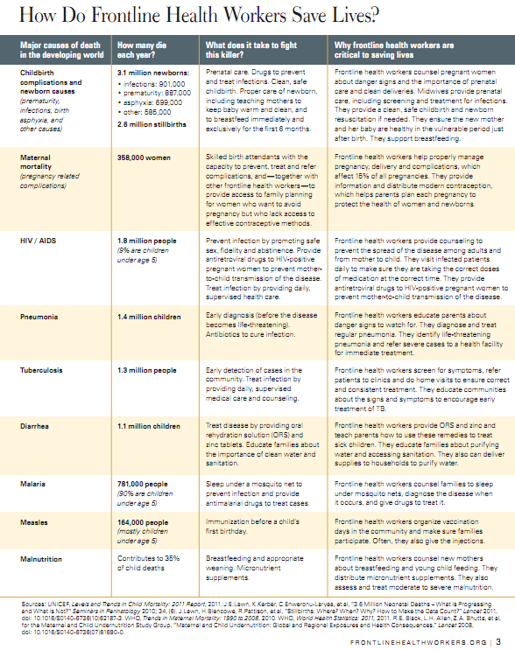
Frontline Health Workers Coalition

Slide 8
Current Illustration: South Sudan (Nelson et al., 2011)
Situation:
Mortality per 1000 live births: 20.5 mothers, 235 children
Malnutrition >25%, Vaccination <10%
Lack skilled MNCH providers, and traditional birth practices in particular are ineffective or harmful
Strategy: Mass General Hospital worked with government to develop CHW strategy:
Five day training course
Pictorial checklists for prevention, care, referral (e.g., danger signs, bleeding, resuscitation)
Re-useable medical equipment, commodities (blood pressure cuff, thermometer, newborn breathing bag)
Result to date: 72 trainers, 632 frontline health workers in 7 states at work

Slide 9
CHWs during emergencies (Johns Hopkins and IFRC 2008)
Often not talked about – they have a key role
CHW extend emergency health care service
Provide preventive, disease control and surveillance
Sensitize people how to improve own health after emergencies
Provide essential prevention/care e.g., Oral Rehydration Solution
Allows health facility staff to concentrate on more severe conditions.
Training: Acute emergency phase training should focus on simple priority tasks that address immediate health needs such as:
Identifying cases and referring seriously ill as early as possible
Identifying vulnerable groups;
Organizing information/education about disaster related disease prevention and control
Data collection of all the above activities.

Slide 10
Are they effective? (Lehman and Sanders for the WHO, 2007)
Answer depends on What CHW program, what type of CHW, and for whom are they effective.
Plenty of evidence that they improve access to and coverage of communities with basic health services
Some evidence that they improve health outcomes esp child health, and particularly pneumonia
Sometimes inconsistent or poor in quality
Must be carefully selected, trained, and adequately and continually supported
Unrealistic expectations by community hampers them

Slide 11
USAID evaluation (2012) – major summit based on a year of investigation with 150 expert informants
Rigorous studies have documented positive effects of CHW, but best way to support CHWs is not understood.
Results viewed through the prism of “dual and overlapping community and formal health systems” (USAID p2)…cannot separate independent contributions of community and formal health system.

Slide 12
One effort to improve effectiveness: Clusters (e.g., Grills et al, 2012)
Band together multiple CH programs to increase visibility, link to government schemes and formal health system
Needed “key brokers and network players”
Also: Similar faith, common friendships, geographic location, common mission.
Motivators: Self interest to increase funds, visibility, credibility, and capacity/access
Barriers: lack of funding, poor communication, limited time and lack of human resources, risk aversion and mistrust.
See: Community Health Global Network (www.chgn.org)

Slide 13
Can they “reach scale”? (Liu et al, 2011)
Reaching a national scale is not as easy as just doing more!
CHW are limited in size, bounded by the limits also of the primary health system that back them up
Tie the resource allocation to communities and their interest
Assure that CHW support a PHC system that is itself intact
Create PHC/CHW teams to coordinate services, including things like day to day operations, household visits, task management, clear referral and follow up loop, and data collection/response (p.430).
Coordinating CHW can also improve the quality of care for treatment/recovery

Slide 14
What drives performance? (Perry and Zulliger, 2012) (categories are mine)
Policy and Operational Context
Effective linkage with formal health system for supervision, continuing education, receipt of supplies and medicines, and referral of patients
Policy framework supportive of CHWs
Community involvement in CHW programs
Adequate and decentralized funding
Adequately resourced supply chain
Systemic monitoring and evaluation of CHW programs
Human resource and motivation
Clear job descriptions (goes with clear program design)
Sufficient number and equitable distribution of CHW
Adequate financial and non-financial incentives
Opportunities for CHW professional growth and career advancement
Training and Supervision
Appropriate pre-service and in-service training
Supportive supervision and constructive feedback

Slide 15
My takeaway
We get confused when we think frontline workers are a different system
Why? Back to Alma Ata – PHC is the first level of contact. So who is “primary” in a system with CHW?
Formal system resists: concerned about ethics and quality of less trained workers rendering aid, despite possible evidence to the contrary.
We need a coherent logic model that incorporates them with the ‘formal’ system.

Slide 16
Mission perspectives on FHW

Slide 17
Three Missions Perspective on FHWs
Mission engages with culture and behavior patterns
IMCI, CIMCI, BCC, etc where confronting ‘health culture’ is important
Church and missions can support this!
Mission members have the opportunity to partner with CHWs, learn their work, community, encourage and see how to pray and support.
Think of an “evolution” in health missions
Holistic health with nutrition, total community planning
Improving health systems, coordination, planning, not just direct service

Slide 18
Think Christianly about health workers
Goal - form Christian professional identity
Christians share their time and resources to help the needy.
Christian health workers strive for standards
Respect for dignity of human life
Concern for the whole person
Ethics in practice and administration
Stewardship for God-given resources
Christians apply prayer and spiritual guidance
(How else do they differ?)

Slide 19
Strengthening the Front…

Slide 20
Address the challenges 1: Policy and Operational Context
Discuss FHW with health centers/hospitals/MOH
Define specific projects, roles for FHW
Assure community leaders and members know that FHW and health centers are linked
Increase communication and coordination
have FHW and nurses communicate
See if FHW can receive some supplies
mHealth initiatives – many now –
Access information and record data
Share patient info for care planning with health centers
Help create clusters of worker networks (see www.cghn.org)

Slide 21
Address the challenges 2: Human Resource
Make sure they have clear job descriptions
See how to improve financial and non-financial incentives
“Adopt a CHW”?
Support the care group concept?
Include in professional development – participate in short term mission events/seminars
Help them get to rural/remote areas
Make sure workers represent/are from community

Slide 22
Address the challenges 3: Training and supervision
Sponsor training and workshops
Send information, books that are locally appropriate and desired
Improve technical and ‘customer service’ skills – this is a focus area that may help effectiveness
Realize that many workers may be illiterate – even if training is basic, may be challenging
Access to modern technology and updated skills
Belief that mission brings “real skills” that people trust
mHealth, eHealth and other technology innovation

Slide 23
The bottom line
Frontline health workers including CHWs are effective at preventing disease/injury, delivering some care, and linking people to health systems.
Christian health systems in particular can benefit from a holistic view that incorporates them in hospital and health center strategies
They need training and reinforcement particularly to excel as Christian health workers.
I think these people who work in the Christian context express very tangibly the love of Christ in their work. God will use that to amplify their effect, as well as their own transformation.

Slide 24
References
Frontline Health Workers Coalition (2012). Frontline Health Workers: The best way to save lives, accelerate progress on global health, and help advance US interests. Downloaded from frontlinehealthworkers.org.
Grills NJ, Robinson P and Phillip M (2012). Networking between community health programs: a case study outlining the effectiveness, barriers and enablers. BMC Health Services Research 2012, 12:206. http://www.biomedcentral.com/1472-6963/12/206
Health Workers Course (2013). Unite for Sight: Health workers online course. http://www.uniteforsight.org/health-workers-course.
Johns Hopkins Bloomberg School of Public Health and International Federation of Red Cross and Red Crescent Societies (2008). The Johns Hopkins and Red Cross Red Crescent Public heath guide in emergencies. 2nd Edition. Geneva: International Federation of Red Cross and Red Crescent Societies. (Accessed from http://www.jhsph.edu/research/centers-and-institutes/center-for-refugee-and-disaster-response/publications_tools/publications/_CRDR_ICRC_Public_Health_Guide_Book/Public_Health_Guide_for_Emergencies)
Lehmann U and Sanders D (2007). Community health workers: What do we know about them? The state of the evidence on programmes, activities, costs and impact on health outcomes of using community health workers. World Health Organization: Evidence and Information for Policy, Department of Human Resources for Health. Geneva, WHO. http://www.who.int/hrh/documents/community_health_workers.pdf
Liu A, Sullivan S, Khan M, Singh P (2011). Community Health Workers in Global Health: Scale and Scalability. Mount Sinai Journal of Medicine 78:419–435.
Love, M, Gardner, K,Legion, V (1997). Community Health Workers: Who they are and What they do. Health Educ Behav August 1997 vol. 24 no. 4 510-522
Nelson BD, Fehling M, Eckardt MJ, et al (2011). Innovative package for frontline maternal, newborn and child health workers in South Sudan. South Sudan Medical Journal 4(4) Nov. 2011 pp 80-82. Downloaded from www.southsudanmedicaljournal.com.
Perry H and Zulliger R (2012). How effective are community health workers? An overview of current evidence with recommendations for strengthening community health worker programs to accelerate progress in achieving the health related Millennium Development Goals. Johns Hopkins Bloomberg School of Public Health. http://www.coregroup.org/storage/Program_Learning/Community_Health_Workers/review%20of%20chw%20effectiveness%20for%20mdgs-sept2012.pdf
US Agency for International Development (2012). Community and formal health system support for community health worker performance: a US Government evidence summit. Final Report. http://www.usaid.gov/sites/default/files/documents/1864/CHW-Evidence-Summit-Final-Report.pdf
Marchant T and Schellenberg J (2013). Measuring skilled attendance at birth using linked household, health facility, and health worker surveys in Ethiopia, northeast Nigeria, and Uttar Pradesh, India. The Lancet 381 Supplement 2, 17-19 June 2013. Pages S88.

