Slide 1
Non-Specialist’s Approach to Pus in the Muscle, Bone and Joints
2011 Global Health Missions Conference
Louisville, Kentucky
Bruce C. Steffes, MD, FACS, FWACS, FCS(ECSA)
Certificate of Knowledge in Clinical Tropical Medicine and Travelers Health (ASTMH)
Notes:
Description: Relatively uncommon in N. America, tropical pyomyositis, acute and chronic osteomyelitis and septic arthritis are frequently encountered by medical missionaries in the developing world. Resources may be poor and specialists rare. This session is designed to give the nonspecialist medico a practical, case-oriented approach to these problems.
Session Problem: Limited knowledge, limited diagnostic skills and limited invasive skills by medical practitioners can lead to delayed diagnosis, excessive patient suffering and avoidable disability.
Session Solution: A better understanding of these conditions and the underlying pathology will allow a higher index of suspicion, more rapid diagnosis and more rapid intervention. It will also give tools and approaches to cure those conditions which might be cured in the setting of limited resources and where cure is not possible, prevent disability and set reasonable expectation without depleting mission and patient resources.

Slide 2
Tropical Triad of Pus
The triad of tropical pyomyositis, septic arthritis and acute osteomyelitis are common and often overlap.
Tends to be a disease of the indigenous peoples (barefoot or other sources of trauma?)
Notes:
The triad of tropical pyomyositis, septic arthritis and acute osteomyelitis are common and often overlap in the same patient. “Metastatic Staph?”
PID – “Pus In Dere” – Muscle, joints and bone. A very common problem in some areas. Syndromes of pyomyositis, septic arthritis and acute osteomyelitis may overlap since the cause (hematogenous spread) and the bacteria (usually Staph) is the same.
Ignoring the usual PID (Pelvic Inflammatory Disease) for this lecture because, while very common, it is remarkable from its counterpart in the Developed World only by its often delayed presentation.
http://www.primary-surgery.org/ps/vol1/ch-7.pdf is a good chapter for the care of this in austere environments

Slide 3
Bacteriology is Similar
Blood cultures usually negative
Wound cultures: 90% or more are hemolytic coagulase positive Staphylococcus (can also be Staph albus, Streptococcus spp and E. coli)
Less common pathogens may be associated with immunosuppression
Notes:
Staphylococcus aureus is the common denominator although other bacteria can be the only cause or part of the problem. Patient who are immunosuppressed have a weirder selection of bacteria.
Blood cultures usually negative, but 90% or more are hemolytic coagulase positive Staphylococcus (can also be Staph albus, Streptococcus spp and E. coli; rarely anaerobes)
Most patients in the tropics lack underlying conditions (but consider undiagnosed HIV). Less common pathogens (and infections in non-tropical situations) may be associated with immunosuppression, e.g. retroviral infections, diabetes, alcoholic liver disease, steroids, sickle cell disease, rheumatoid arthritis, lymphoma and multiple myeloma.

Slide 4
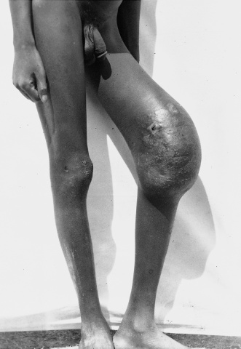
Pyomyositis
Abscesses of heavy proximal muscles of trunk and limb
Often multifocal – time and space.
Notes:
Abscesses of heavy proximal muscles of trunk and limb (including psoas & pectoral muscles)
Absence of previous infection or trauma in most cases (“metastatic Staph”). Up to 50% will give a history of minor trauma or vigorous exercise although this may be just an attempt to find an explanation rather than causal.
Eosinophilia is often present in patients with tropical pyomyositis suggesting that migrating helminths may be the source of bacterial inoculation in some cases. Again, this may be two common conditions occurring together.
Often multifocal – time and space.
Tend to be disease of the native peoples (Europeans can be infected but rarely are) and children more than adults.

Slide 5
Clinical Presentation
Early stage
  Low grade fever, local swelling (no erythema), mild pain and tenderness.
  Muscle is “woody” rather than fluctuant
  Lasts 10 – 12 days
Notes:
The early stage of pyomyositis is characterized by subacute onset of fever, with local swelling of the involved area but no erythema and only mild pain and tenderness. At this stage, the muscle feels woody or indurated rather than fluctuant, and aspiration does not yield pus. The early stage typically lasts 10-12 days.

Slide 6
Clinical Presentation
More swelling, and overlying skin shows inflammation (not always)
Aspiration positive for pus
Marked pyrexia and pain
Can progress to systemic sepsis, multiple abscesses and toxic shock syndrome
Notes:
As infection progresses, localized muscle swelling and pain become more prominent and the overlying skin develops characteristic signs of inflammation. (With very deep muscle infections, skin changes may remain minimal or appear only late). Aspiration at this stage will yield pus. This stage demonstrates marked pyrexia and pain.
If the infection is not treated promptly, it can progress to systemic sepsis and metastatic infection in other muscles and tissues. Some patients will present with abrupt onset of high fever and/or signs of toxic shock syndrome.

Slide 7
Diagnosis and Treatment
High index of suspicion
Aspiration, ultrasound and /or CT
Psoas abscess – can be confused with multiple other diagnosis
Early antibiotic coverage with coverage of Staph aureus. Gram stain may change coverage.
Notes:
Early diagnosis (ultrasound, aspiration). High index of suspicion. Psoas abscesses can be confused with appendicitis, septic arthritis of the hip, etc.
Early antibiotics with empiric coverage of Staph aureus (cloxacillin, cefazolin, cephalexin, clindamycin) as soon as diagnosis suspected. Gram stain and culture results should modify antibiotic therapy appropriately. Parenteral antibiotics until systemic signs of infection resolve.

Slide 8
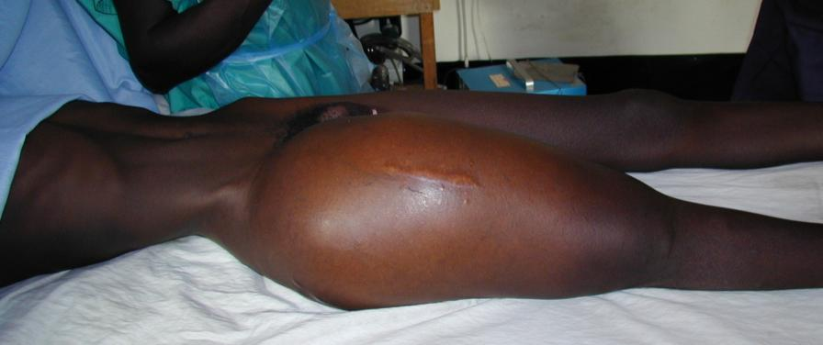
Pyomyositis
Notes:
Early diagnosis (ultrasound, aspiration). High index of suspicion. Psoas abscesses can be confused with appendicitis, septic arthritis of the hip, etc.
Early antibiotics with empiric coverage of Staph aureus (cloxacillin, cefazolin, cephalexin, clindamycin) as soon as diagnosis suspected. Gram stain and culture results should modify antibiotic therapy appropriately. Parenteral antibiotics until systemic signs of infection resolve.

Slide 9
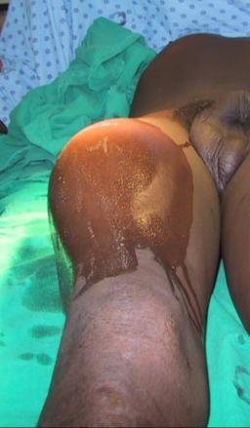
Surgery - Pyomyositis
Do not filet. Instead make several counter incisions at the edges of the cavity and put through-and-through Penroses in
Splint to avoid contractures if likely
Notes:
Place multiple Penrose drains through incisions at placed at the periphery of the cavity (ends tied together). This is better than filleting it open completely and packing it. Irrigate along Penrose drains in post-operative period.
Splint to avoid contractures if likely
Multifocal disease is common and may follow within a day or two. Fever which doesn’t resolve suggests inadequate drainage of same or other abscess

Slide 10
Septic Arthritis
Hematogenous septic arthritis involves knee, hip, shoulder and ankle in that order.
Septic arthritis can occur from adjacent metaphyseal osteomyelitis (up to six months of age for all joints except the hip where it can be later) and penetrating injury
Notes:
Septic arthritis involves the big joints – the knee, hip, shoulder and ankle in that order – and spreads hematogenously.
In young children, it can also spread from a focus of osteomyelitis in the adjacent metaphysis. In any age, it can also be the result of penetrating injury to the joint.

Slide 11
Presentation of Septic Arthritis
      High fever can occur, but only half of the patients have leukocytosis or fever.
      Pain with movement (refusal to move) is the first and sometimes only sign.
      Multiple joints may be involved.
        The knee and ankle may have palpable warmth and swelling;
        The hip and shoulder is not likely to until very late.
        In spine, SI joint and hips, pain may be only symptom.
      The elderly may not have any symptoms – all joint effusions should be aspirated!
Notes:
Pain with movement (or the refusal to move) is the first and often only sign. Fever is variable and is not always present. Consistent with its hematogenous mode of spread, it is not surprising that multiple joints will be affected. The knee and ankle are often red and obviously involved, The deep joints are not likely to have visible or palpable changes.
Elderly may not have any symptoms – aspirate all joint effusions.

Slide 12
Bacteriology of Septic Arthritis
      S. aureus is most common
      H. influenzae is most frequent in newborns
      Sickle cell anemia patients may have E. coli or salmonella.
      Streptococci, brucellae and gonococci can also occur (gonococcs is usually in the sexually active).
Notes:
S. Aureus is the major cause, but newborns can have H. flu and SCA patients have salmonella or E.coli. Strep, Brucella and gonococci can also cause septic arthritis.

Slide 13
Treatment of Septic Arthritis
ASPIRATE as soon as the diagnosis is suspected.
If positive (gram stain, cloudy synovial fluid or frank pus), take to OR, open joint, irrigate copiously, feel surfaces of the joint and place drain (can leave the knee open in some cases).
Since shoulder and hip may be difficult to aspirate, high index of suspicion requires opening the joint in the OR.
Splint in position of function and then begin active ROM by day 10.
Notes:
A needle and a high index of suspicion are all that is required to make the diagnosis of septic arthritis. Aspirate, aspirate, aspirate. If positive, then take to the OR to clean out the joint. Since the hip and shoulder are sometimes difficult to aspirate, take them to the OR when the diagnosis is seriously considered. Split to avoid contractures and begin active range of motion by day 10.

Slide 14
Acute Osteomyelitis
Early diagnosis and aggressive treatment necessary to avoid chronic osteomyelitis
Chronic osteomyelitis is rarely cured in the Developing World)
Notes:
You almost never are able to cure chronic osteomyelitis in the Developing World. You only chance it to make the diagnosis of acute osteomyelitis early and following it with aggressive treatment. Long-term antibiotics are just not affordable or feasible.

Slide 15
Presentation of Acute Osteomyelitis
Pain in the affected bone (most commonly, tibia, femur or humerus).
Often history of recent trauma but it is not necessary
Pain severe with high fever and exam tends to be unremarkable except tenderness to gentle percussion.
Usually begins in the metaphyses of long bones in children, especially, tibia, femur and humerus.
Notes:
Localized severe pain with high fever is the most suggestive sign of acute osteo. The extremity may look normal and the physical exam is often not remarkable except the presence of localized tenderness.

Slide 16
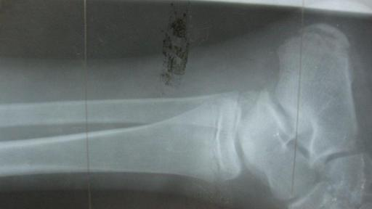
Diagnosis of Acute Osteomyelitis
In this setting, the diagnosis is clinical and requires a high index of suspicion
Ultrasound may show periosteal edema but x-rays often negative
Courtesy Dr. D. Anderson, Ethiopia
Notes:
Likewise, x-rays are often normal. There may be some fluid or edema on ultrasound.

Slide 17
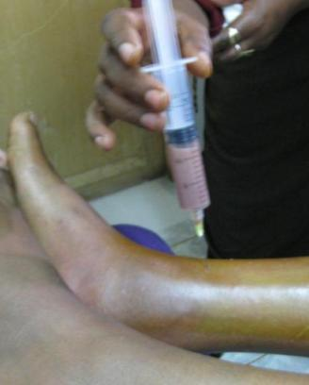
Treatment of Acute Osteomyelitis
Aspiration
Anti-Staph antibiotics with splinting and elevation of the limb
Courtesy Dr. D. Anderson, Ethiopia
Notes:
Aspirate as soon as possible. Begin anti-staphylococcal antibiotics, splint and elevate the limb.

Slide 18
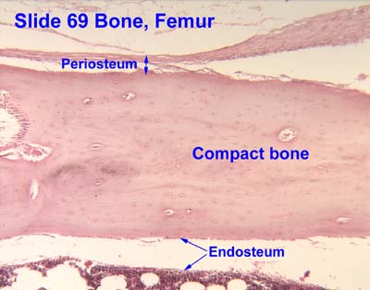
Bone Nutrition

Slide 19
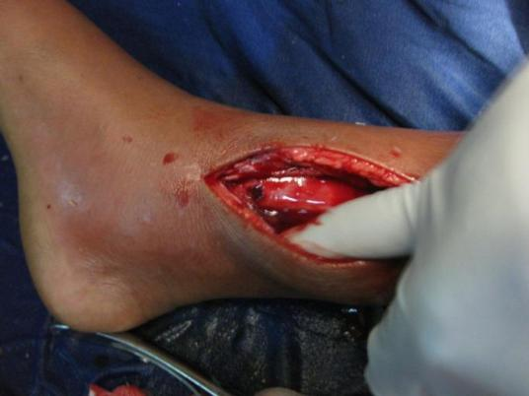
Treatment of Acute Osteomyelitis
Immediate decompression with drilling of affected bone (and creating a osteotomy if positive)
Courtesy Dr. D. Anderson, Ethiopia
Notes:
Since the pus strips the periosteum and the internal endosteum off the bone which will then cause the bone to die for lack of blood supply, it is important to decompress both the external and internal abscesses. Drilling the bone in the suspicious case are may reveal pus. If it is positive, multiple drill holes or preferably a trough osteostomy is necessary to adequately drain the pus in the medullary cavity. It is then allowed to heal by secondary intention.

Slide 20
Subsequent Treatment
IV antibiotics for prolonged periods are not feasible or affordable
When fever subsides, switch to oral antibiotics (x-rays will be positive)
Continue antibiotics until fever, pain and swelling are resolved; ESR is normal
Notes:
IV antibiotics for six weeks or more are not feasible nor affordable in this environment. When the fever subsides and the wound is healing, switch to oral antibiotics (the x-rays will still be abnormal). Continue oral antibiotics until the fever, pain and swelling are resolved and the ESR is normal. If you are a man or woman of faith, prayer helps.

Slide 21
    Chronic Osteomyelitis
Definitions:
  A sequestrum is a piece of dead bone that has become separated during the process of necrosis from normal/sound bone.
  The involucrum is a layer of new bone growth outside existing bone seen in pyogenic osteomyelitis. It results from the stripping off of the periosteum by the accumulation of pus within the bone, and new bone growing from the periosteum.

Slide 22
Goal of Therapy
Chronic osteomyelitis in the developing world can rarely be cured. The attempt is to gain good function/diminished drainage for several years until it flares again.
Antibiotics will have little affect (alone) if the sequestrum is not removed.

Slide 23
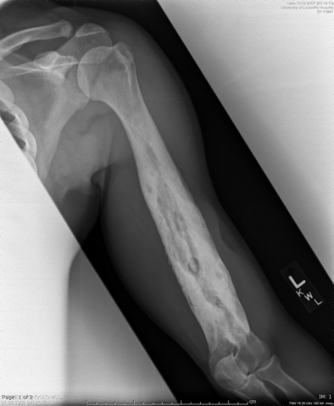
Removal of the Sequestrum
Do not prematurely remove large sequestra of the long bones (esp. humerus, tibia and femur),
The involucrum must develop sufficiently to stabilize the limb before the dead bone is removed
Cast or external fixation may be necessary to stabilize the limb

Slide 24
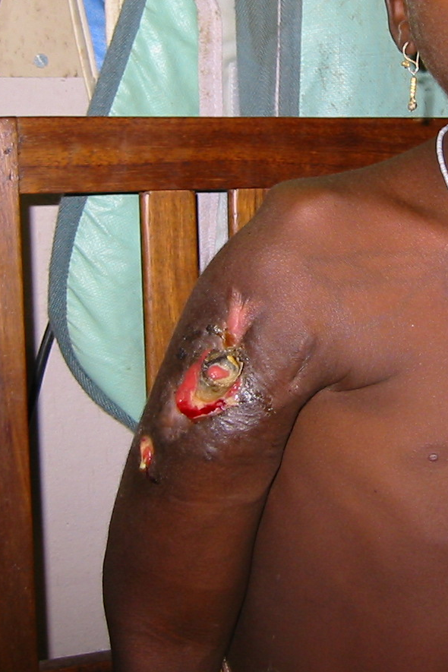
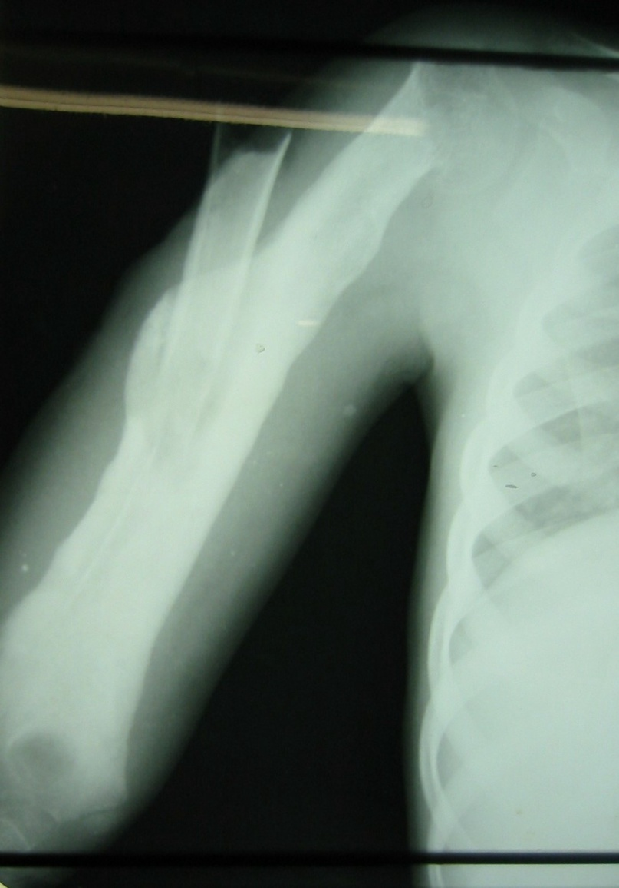
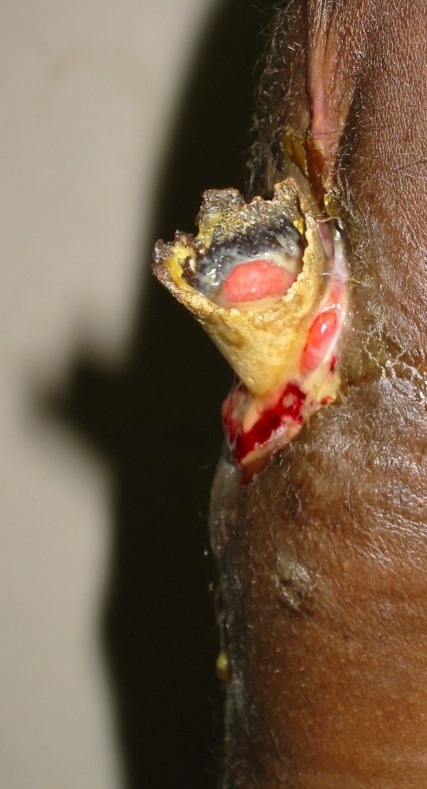
Chronic Osteomyelitis

Slide 25
Removal of the Sequestrum
In the case of smaller sequestra, it can be removed immediately since the bone is stable around it. It is whiter than the living bone and distinct sharp edges.

Slide 26
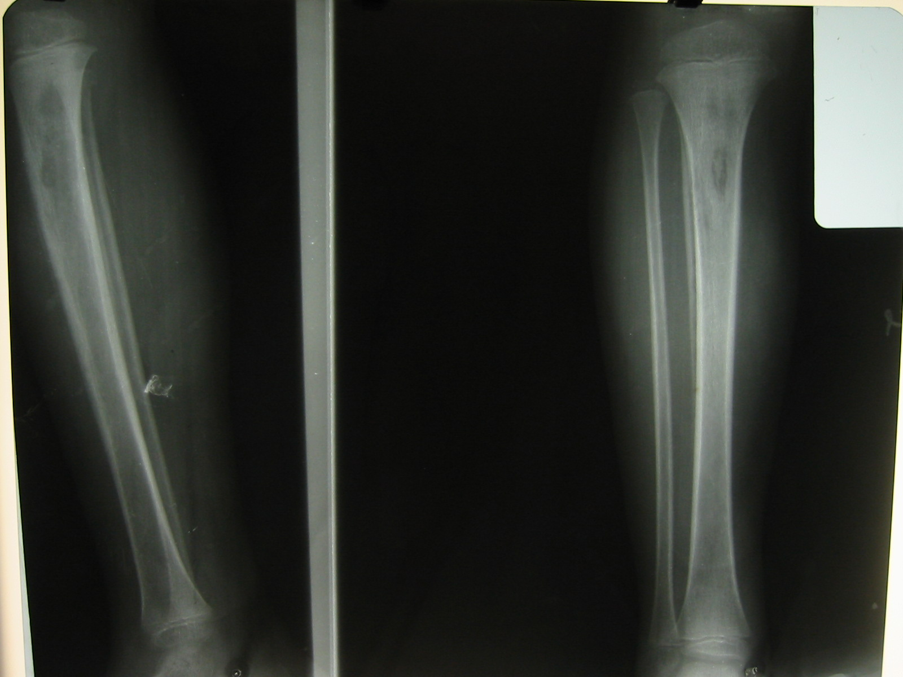
Small Sequestrum

Slide 27
Soft Tissue is Vital
Bone heals best with soft tissue coverage
Rotation or transfer flaps may be required.

Slide 28
Ludwig’s Angina
Streptococcal ssp (anaerobic), Staphylococcus and Bacteroides from the mouth.
Penicillin/metronidazole and/or clindamycin – may respond to only antibiotics and not require surgery.
Usually due to abscess of 2nd and 3rd lower molars.
Notes:
The last topic for today is more pus – but not Staphylococcal this time. Ludwig’s angina is a spreading infection usually due to abscesses of 2nd and 3rd lower molars. Streptococcal ssp (anaerobic), Staphylococcus and Bacteroides from the mouth are the usual culprits and Penicillin/metronidazole and/or clindamycin are indicated.

Slide 29
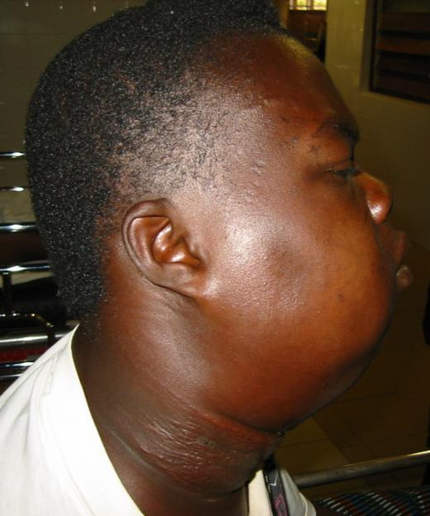
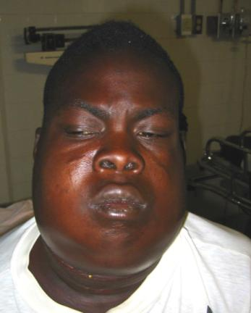
Ludwig’s
Notes:
It is difficult to be sure where the abscess is on exam because of the extensive edema this cellulitis causes.
CT with contrast is preferred, but ultrasound can give a lot of information.
65% or more of these patients will require drainage; the rest can be treated with elevation of the head and antibiotics

Slide 30
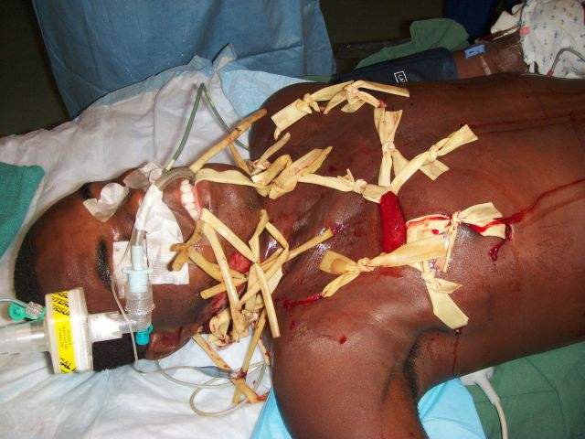
Ludwig’s to Fasciitis
Notes:
The submandibular space is the primary site of infection but the pus can spread to the sublingual space, the pharyngomaxillary and the retropharyngeal spaces
This can encircle the airway and cause protrusion of the tongue and loss of airway.
This picture is not a man from an explosion in the Penrose factory. The infection had progressed onto the chest as a necrotizing fasciitis.

Slide 31
Pearls – Ludwig’s
Remember airway – a definitive or surgical airway may be necessary. Progress of the disease can be rapid (within hours).
Early dental consult
Look for associated mandibular osteomyelitis
Drain abscesses when they become evident – multiple drains at extent of abscesses.
Notes:
Compromise of the airway can be rapid. Ask for a dental consult – the sooner the offending tooth is pulled, the sooner the abscess can be decompressed that way. Mandibular osteomyelitis is often associated with this, either simultaneously or subsequently. Drain the abscesses as soon as you are reasonably certain you know where they are.

Slide 32
Empyema
Treatment doesn’t really change but the lack of suction and other equipment may cause reversion to 50 years ago.
Aggressive use of chest tubes (and breaking up loculations)
Conversion to empyema tubes
Eloesser flaps may be necessary – but are morbid
Notes:
http://ps.cnis.ca/wiki/index.php/Pus_in_the_pleura,_the_pericardium,_and_the_peritoneum
Aspirate completely if watery – high recurrence rate and may require tapping every other day until no more forms (or it gets too thick to drain)
If pus is thicker, place a chest tube to water seal. This tube may stay six to 12 weeks, so place it
In a comfortable position if possible
At the lowest possible (dependent) position [one rib space above the diaphragm to avoid blockage by the diaphragm] – may vary if patient is confined to bed as opposed to an ambulatory patient
Open drainage
Used when closed drainage fails. Pleural adhesions must have formed.
Small ones may be done under rib block – break up loculations with finger before placing drain.
Eloesser flaps may be required but are usually done by a specialist. They have significant morbidity in the DW.
Pearls
Don’t drain tubercular empyema (empyema necessitans)
The chest tube should be a 30 Fr or above. This may require resection of a short piece of rib
Antibiotics are helpful for the pneumonia, but not the empyema
Although King’s textbook states you can pull the tube, most are best converted to a chest tube
If air comes out with the pus, a bronchopleural fistula may be present. Suction will be required for the chest tube (most of the time). Refer to specialist.
Decortication may be needed (refer if you are unable to perform it).

Slide 33
Pott’s Disease
Greatest number of cases in lower thoracic spine and upper lumbar spine. Vertebral body (rather than posterior elements) involved.
1 – 1.5% of all TB patients will have tubercular disease of the spine.
The caseating granulomas (with or without pus) spare the discs and travel under the longitudinal ligaments.
Involvement of the epidural space is most likely to cause permanent neurologic damage

Slide 34
Differential Diagnosis of Pott’s
Pediatric - Lack of many other likely possibilities
  Scheuermann’s disease
Adults – many including:
  pyogenic and fungal infections
  metastatic disease
  primary tumors of bone
  Sarcoidosis
  giant-cell tumors of bone.

Slide 35
Symptoms of Pott’s Disease
Slowly progressive constitutional symptoms – weakness, malaise, night sweats, fever and weight loss.
Spinal deformity and swelling occur later.
Pain is late sign associated with bone collapse and paralysis.
Neurologic signs usually occur late, may wax and wane. Presence of motor function and rectal tone are good prognostic predictors.

Slide 36
Indications for Surgery in Pott’s
Absolute indications:
  Uncontrolled spasticity
  The onset of any sudden severe paraplegia
In the face of adequate drug therapy:
  the onset of gradual paraplegia
  worsening of paraplegia
  present of motor loss after 1 month
  severe paraplegia after six months.

Slide 37
Indications for Surgery in Pott’s
Other indications
  Resistance to chemotherapy
  Recurrence of disease
  Severe kyphosis with active disease
  signs and symptoms of cord compression
  progressive impairment of pulmonary function
  progression of the kyphotic deformity

Slide 38
Surgery for Pott’s in Austere Conditions
Surgery often not available.
Open biopsy for diagnosis, debridement and bone grafting may be indicated especially with more than one vertebral level.
Ribs, iliac crest and fibular can be used as grafts – incidence of late stress fracture.
External mobilization is necessary when grafting is done.
Posterior fusion in addition is desirable if available

Slide 39
Results – Surgery in Pott’s
70 – 90% with paralysis will recover with the surgery

Slide 40
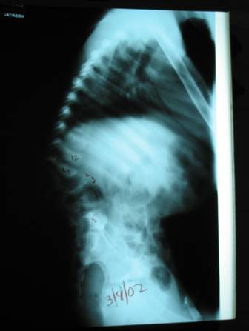
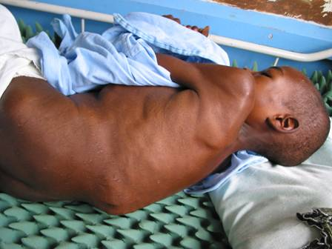
Pott’s

Slide 41
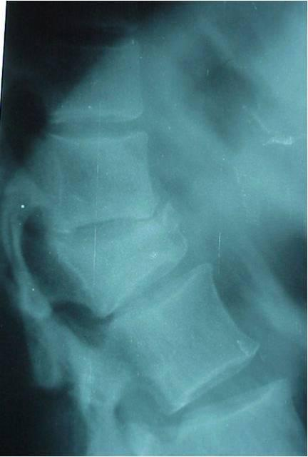
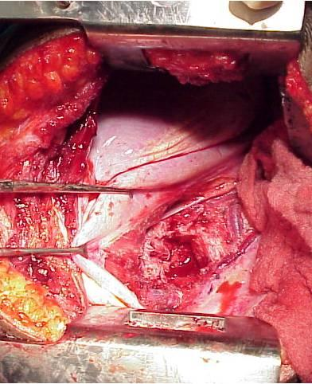

Slide 42
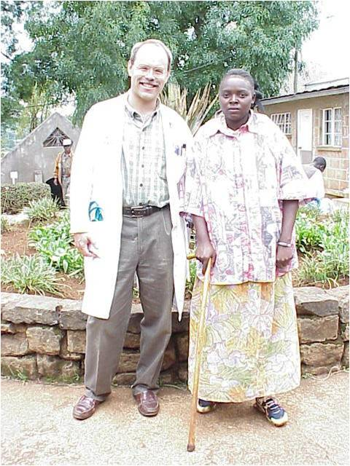
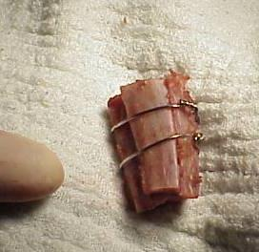
Courtesy of Dr. R. White, Kenya

Slide 43

Thank you!
ceo@paacs.net
Notes:
Thank you for your attention. I would be glad to answer any questions you may have to the best of my ability to do so. I would encourage each and every one of you to become involved in humanitarian work – quitting my practice to do this has been the best thing I have ever done.

