Slide 1
Malaria
Global Missions Health Conference
Louisville, Kentucky
November 2014
fischer.phil@mayo.edu

Slide 2
Objectives
Know about the parasites causing malaria, the insects that transmit malaria, and the people who get malaria.
Be able to prevent and manage malaria during pregnancy, childhood, and travel.
Disclosures: None

Slide 3
The Villains

Slide 4
Plasmodium and Human Malaria
How many Plasmodium species cause malaria in humans?
A. 3
B. 4
C. 5
D. 6

Slide 5
Plasmodium and Human Malaria
P. falciparum – common, kills, resists meds
P. vivax – fairly common, rarely fatal
P. ovale – uncommon, mostly West Africa
P. malariae – uncommon, Asia and Africa
P. knowlesi – Malaysia and beyond!
Clin Infect Dis 49:852, 2009

Slide 7
How Many Plasmodium Species
Cause Human Malaria?
1. P. falciparum
2. P. vivax
3. P. ovale curtisi
4. P. ovale walleriki
5. P. malariae
6. P. knowlesi
Sutherland et al. J Infect Dis 201:1544, 2010

Slide 8
What is the Most Dangerous Animal in the World?

Slide 9
What is the Most Dangerous Animal?
  Bat? Ebola ~13,000 cases in 2014

Slide 10
What is the Most Dangerous Animal?
  Bat? Ebola ~13,000 cases in 2014
  Dog? Rabies ~55,000 cases/year

Slide 11
What is the Most Dangerous Animal?
  Bat? Ebola ~13,000 cases in 2014
  Dog? Rabies ~55,000 cases/year
  Mosquito? YF ~200k cases, 30k deaths/yr
  Dengue ~50 million cases/yr
  JEV ~75k cases/year
  Chikungunya now in Europe and America
  Malaria ~200 million cases/yr
  ~1700 deaths/day

Slide 12
What is the Most Dangerous Animal?
  Bat? Ebola ~13,000 cases in 2014
  Dog? Rabies ~55,000 cases/year
  Mosquito? YF ~200k cases, 30k deaths/yr
  Dengue ~50 million cases/yr
  JEV ~75k cases/year
  Chikungunya now in Europe and America
  Malaria ~200 million cases/yr
  ~1700 deaths/day
  Human?

Slide 13
What is the Most Dangerous Animal?
  Bat? Ebola ~13,000 cases in 2014
  Dog? Rabies ~55,000 cases/year
  Mosquito? YF ~200k cases, 30k deaths/yr
  Dengue ~50 million cases/yr
  JEV ~75k cases/year
  Chikungunya now in Europe and America
  Malaria ~200 million cases/yr
  ~1700 deaths/day
  Serpent?

Slide 14
The Vector

Slide 15

Not only poor people should experience this…

Slide 16
good news
Since turn of millennium…
only about half as many deaths/year
~20% drop in number living at risk
Noor et al. J Infect Dis 383:1739, 2014

Slide 17
Anopheles Mosquitoes
Females eat blood, not males.
Usually bite from dusk to dawn.
Eat indoors and outside.

Slide 18
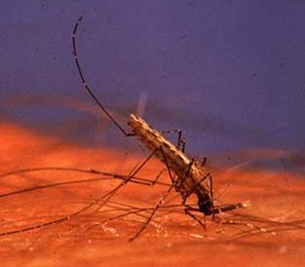
“Bottoms Up”

Slide 19
The Victims

Slide 20
The Victims
Pregnant Women

Slide 21
Malaria in Pregnancy
Insects

Slide 22
Attraction of Mosquitoes to Women
Lindsay et al. Lancet 355:1972, 2000
6.3 (pregnant) vs. 3.1 (non-pregnant)
Anopheles in room per night

Slide 23
Entry into Bednets by Mosquitoes
Ansell et al. Trans R Soc Trop Med Hyg 96:113, 2002
1.7 - 4.5 times
more mosquitoes in net
if woman pregnant

Slide 24
Malaria in Pregnancy
Insects
Pregnant women are
particularly attractive to mosquitoes.

Slide 25
The Victims
Pregnant Women
Children 90% of deaths

Slide 26
The Victims
Pregnant Women
Children 90% of deaths
Travelers 1500/year in US

Slide 27
Once upon a time…

Slide 28
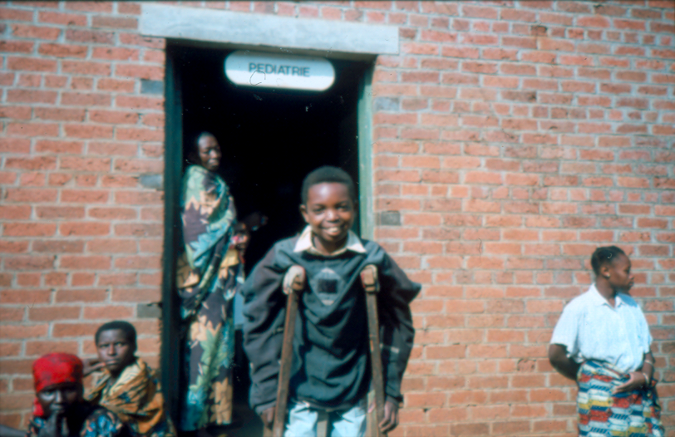

Slide 29
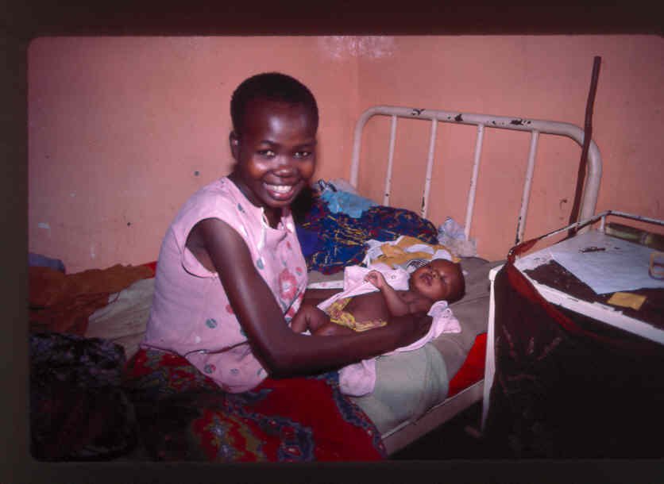

Slide 30
The newborn had fever during the night, but we gave chloroquine. The baby is fine now.
Nurse, on rounds, 1987

Slide 31
In indigineous populations, “the incidence of congenital malaria is exceedingly low.”
Sir G. Covell
Tropical Disease Bulletin 1950

Slide 32
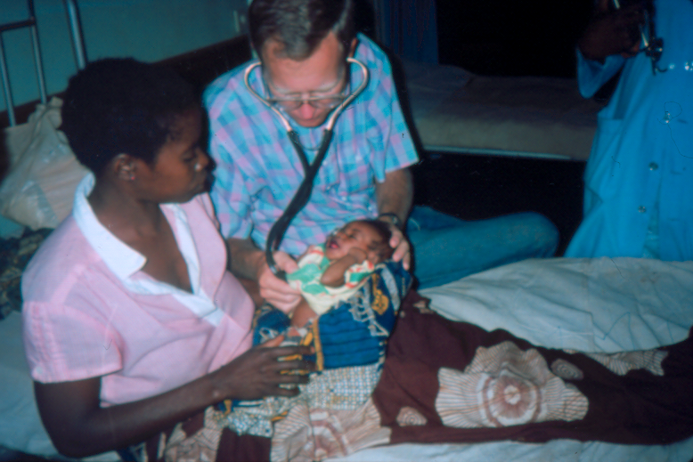

Slide 33
The newborn had fever during the night. The malaria smear was positive, and we gave chloroquine. The baby is fine now.
Nurse, on rounds, 1987

Slide 34
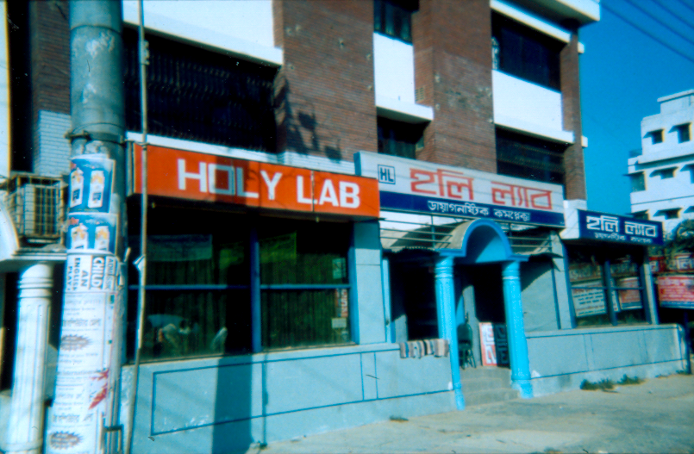

Slide 35
Stop.
Look.
Listen.

Slide 36
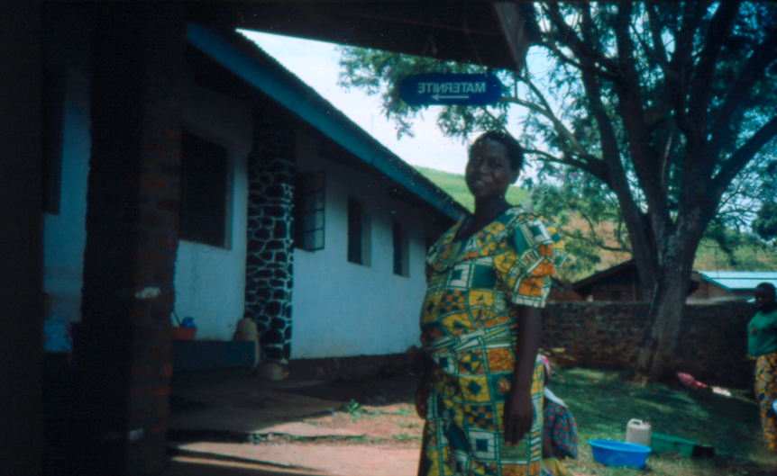

Slide 37
What are the effects of maternal malaria on newborns?

Slide 38
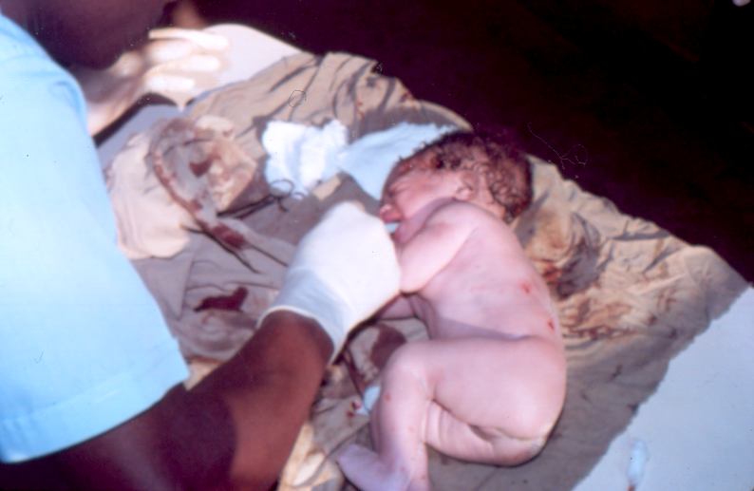

Slide 39
Fever?
36 of 297 newborns with parasites
18 of 297 newborns with fever
6 of 18 with parasites
Fever ~ Parasitemia (RR 3.4)
Clin Infect Dis 16:127-132, 1993

Slide 40
Neonatal Death?
6 of 297 newborns died in 1st 48 h
5 of 6 with maternal parasites (RR 12.4)
3 of 6 with neonatal parasites (RR 7.2)
Clin Infect Dis 16:127-132, 1993

Slide 41
Since 1993 …
~ 7% of newborns parasitemic
Some sick, a few dying
Increased focus on gestational malaria

Slide 42
Poor Pregnancy Outcomes
Burundian Refugees in Tanzania
Fetal Death 4.6%
Low Birthweight 22.4%
Neonatal Death 2.9%
Malaria During Pregnancy >> RR 2.0
JAMA 283:397-402, 2000

Slide 43
Malaria and Early Outcomes
Gambia
Placental Malaria Linked To:
Pre-Term Delivery & IUGR
Low Birthweight (OR 4.4)
Still Born (OR 2.2)
J Health Popul Nutr 20:4-11, 2002

Slide 44
Infant Effects of Maternal Malaria
Later Malaria?
Placental Malaria (42 of 197)
Southern Cameroon
Not Related to Antibody Levels
Increased Malaria at 4-6 months
Am J Epidemiol 146:826-831, 1997

Slide 45
Infant Effects of Maternal Malaria
Anemia?
252 pregnant women in Malawi
2 month infant follow-up
64 (25%) anemic (hematocrit < 25%)
Placental malaria strong risk (RR 2)
Am J Trop Med Hyg 51:170-174, 1994

Slide 46
Infant Effects of Maternal Malaria
Low Birthweight
Fetal Anemia
Neonatal Fever
Neonatal (and Later?) Death
Malaria During Second Month
Malaria at 4-6 Months
Anemia at 2 Months
J Trop Pediatr 49:132-134, 2003

Slide 47
Insecticide-Treated Bed Nets
Pregnant Women
Less placental malaria
Fewer babies of low birthweight
Less stillbirth/miscarriage (up to G₄)
Gamble et al. Cochrane Database Syst Rev. 2:CD003755, 2006

Slide 48
Intermittent Preventive Treatment
IPTp
Monthly SP helps
less maternal parasitemia
less LBW, less prematurity
Less placental malaria in Malawi
2 vs 6% if HIV-negative
8 vs 22% if HIV-positive
Community approach helps
Filler et al. J Infect Dis 194:286, 2006
Meshnick et al. J Infect Dis 194:273, 2006
Falade et al. Malaria J 6:88, 2007
Mbonye et al. Int J Infect Dis, 2007

Slide 49
Intermittent Preventive Treatment
IPTp
Reach women during early pregnancy!
Huynh BT et al. Clinical Infectious Diseases, online 10-2014

Slide 50
A 1 ½ year old comes in obtunded and febrile. She is pale and yellow.
What do you do?

Slide 51
Test for Malaria
Thick Smear - to see if parasites present
Thin Smear - to determine species of Plasmodium
Rapid Antigen Tests - if affordable, accurate
Endeshaw et al. Trans Royal Soc Trop Med Hyg 104:467, 2010
PCR - maybe in a few years

Slide 52
Clinical Presentations of Malaria
Children
Usually high fever, persistent for days
Often vomiting, diarrhea
Tachypnea a poor prognostic sign
Big liver/spleen with repeated bouts
Semin Pediatr Infect Dis 16:105:2005
Adults (“Semi-Immune”)
Usually milder symptoms

Slide 53
Diagnosis of Malaria in Children
Should We Test?
Microscope Training vs Clinical Training vs Nothing
37% less malaria Rx
Fewer antibiotic prescriptions
More symptoms at day 7
Less parasitemia at day 7
Smears 75% sensitive
Smears 59% specific
Tanzania Malaria J 7:199, 2008
Diagnostic training saves money, maybe not lives.

Slide 54
Diagnosis of Malaria in Children
Should We Test?
Outpatients > 5 years of age in Kenya
Rapid Diagnostic Tests led to:
High Transmission Area Low Transmission Area
61% less over-treatment 36% less under-treatment
8% more under-treatment
21% lower costs 41% higher costs
Kenya Am J Trop Med Hyg 78:884, 2008
Results vary in differing settings.

Slide 55
Diagnosis of Malaria in Children
How Good Might Rapid Diagnostic Tests Be?
Compared to expert microscopy:
hypoendemic mesoendemic
sensitivity 90 % 91%
specificity 99.9% 65%
pos pred value 90 % 72%
Sensitivity higher if:
later in season older children higher parasitemia
Kenya/Uganda Malaria J 7:202, 2008

Slide 56
The Diagnosis of Malaria
Rapid Diagnostic Tests
75 (low parasitemia) -95% sensitivity in lab
76 (low parasitemia) -90% sensitivity in field
Bjorkman A. Clin Infect Dis 51:512, 2010
Rapid Diagnostic Test (ParaHit-f)
603 febrile Tanzanian children with neg test
NO bad malaria outcomes if treatment withheld
D’Acremont V. Clin Infect Dis 51:506, 2010

Slide 57
How Good Are
Rapid Diagnostic Tests?
Non-severe malaria, Tanzania, young children
Sensitivity (vs slide read x 2) 97.8%
Specificity 96.3%
Mtove et al. Malaria J 10:290, 2011

Slide 58
How Good Are
Rapid Diagnostic Tests?
Mali, Smear-Positive Patients
Histidine-Rich Protein 2-based Rapid Diagnostic Test
~5% RDT-negative
Associated with absence of HRP2 gene
Koita et al. Am J Trop Med Hyg 86:194, 2012

Slide 59
How Good Are
Rapid Diagnostic Tests?
Currently advised to test and treat accordingly
HRP-2 is probably best
Beware emerging false negatives
Rosenthal PJ. Am J Trop Med Hyg 86:192, 2012

Slide 60
How Good Are
Rapid Diagnostic Tests?
Non-severe malaria, Tanzania, young children
Sensitivity (vs slide read x 2) 97.8%
Specificity 96.3%
~1% with bacterial pathogen (+/- malaria)
Mtove et al. Malaria J 10:290, 2011
With severe malaria
significant risk of Gram-neg bacteremia

Slide 61
Malaria and Bacteremia
Children in Kenya
29% in community with parasitemia
62% of bacteremia patients with malaria
~ 60% Gram negs (2/3 NT Salmonella)
~ 40% Pneumococcus
Sick with “malaria”? Think concurrent bacteremia!
Scott et al. Lancet 379:1316, 2011

Slide 62
Malaria and Malnutrition
Children in Gambia with Severe Acute Malnutrition
~15% bacteremic
non-typhoidal Salmonella
S pneumoniae
E. coli
Sick with “malnutrition”? Think concurrent bacteremia!
Okomo et al. Int J Pediatr e-pub, July 2011

Slide 63
Treating Malaria
Hospitalize if:
Altered mental status
Tachypnea
Acidotic?
Anemic?
Parenteral medication if:
Critically ill (coma, moribund)

Slide 64
Treatment of Severe Malaria - Adults
Artemether IM ~ Quinine
3.2 mg/kg x 1 first day 20 mg/kg load
1.6 mg/kg daily x 4 days 10 mg/kg x 3 x 7 days
PrayGod et al. Malaria J 7:210, 2008
Artesunate IV > Quinine
2.4 mg/kg at 0, 12, 24
Then IV/po daily to 7 days
35% lower mortality with artesunate
Trans Royal Soc Trop Med Hyg 101:633, 2007
Artemisinin derivatives:
often used alone Malaria J 7:96, 2008
often not available Malaria J 7:96, 2008
not well-studied in kids Cochrane Database Syst Rev
17(4):CD005967, 2007

Slide 65
Treatment of Severe Malaria - Children
Compelling Data
11 centers in 9 African countries
5425 children
Artesunate vs Quinine
Death 8.5% 10.9%
Coma 3.5% 5.1%
Neuro Sequelae same
So, replace quinine with artesunate?
Dondorp et al. Lancet 2010;376:1647.

Slide 66
Artesunate vs Quinine for Severe Malaria
8 trials including 1664 adults, 5765 children
Artesunate >> Less Death (RR .61 adult, .76 child)
Artesunate >> More Neuro Sequelae at DC
(but no difference at 4-wk follow-up)
Artesunate would save 26 more lives for each 1000 children treated
Cochrane Database of Systematic Reviews CD005967, 2012

Slide 67
Treatment of Severe Malaria - Children
Since Quinine Often More Available …
Loading dose is good (20 mg/kg probably better than 15)
Initial IM “load” en route to hospital is appropriate
Then, IM dosing (10 mg/kg every 8 hrs) is probably okay
Hypoglycemia is prevented with slower IV infusion rates
Musilla et al. Malaria J 10:201, 2011

Slide 68
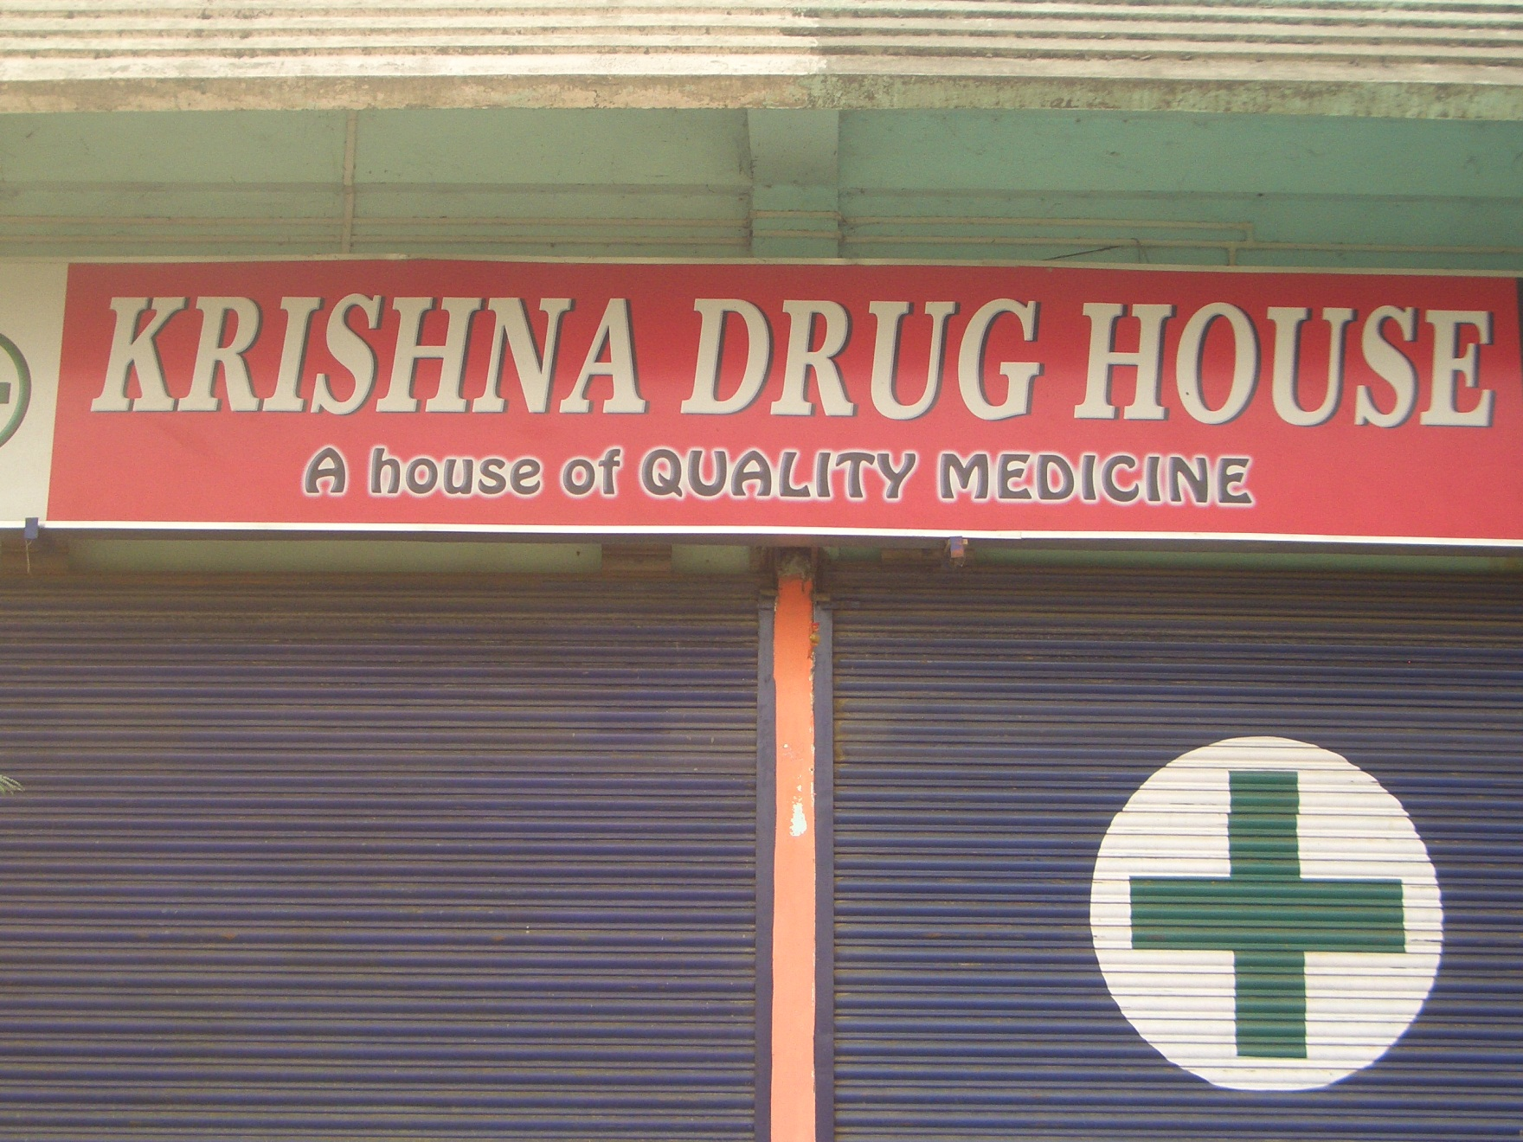

Slide 69
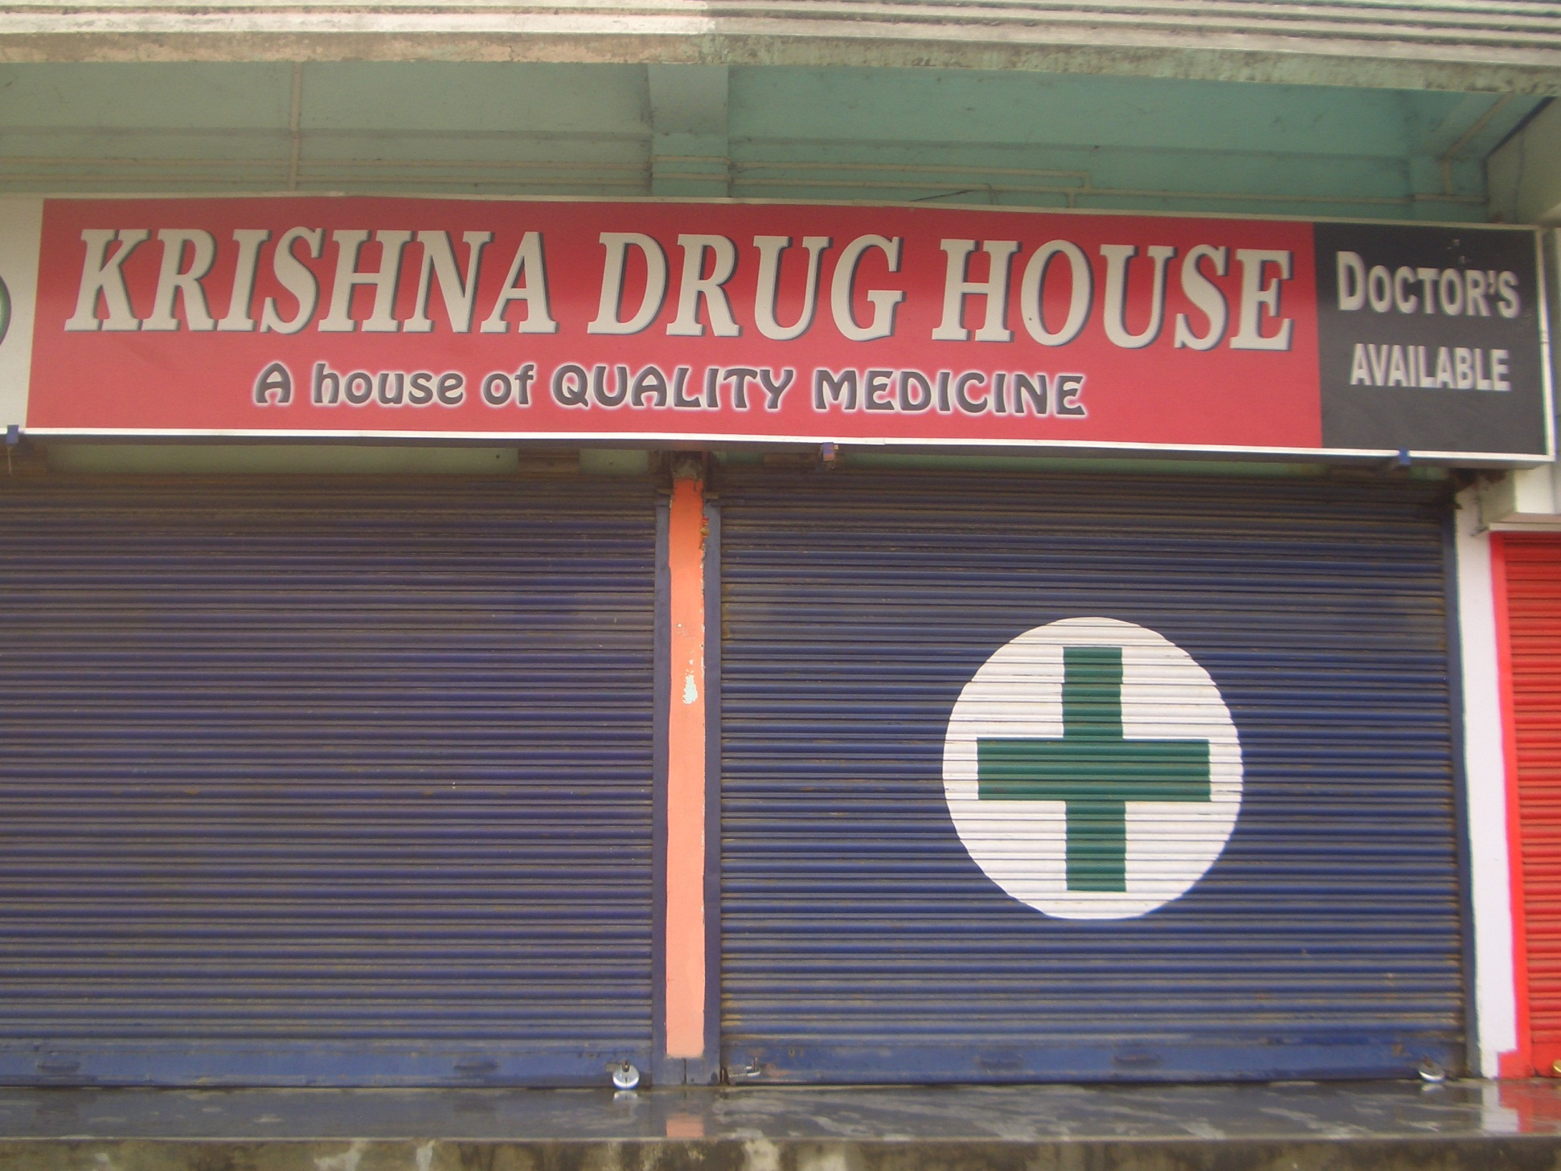

Slide 70
Sick with Malaria
A 1 year old has high fever, RR 60, HR 170, systolic BP 80, decreased mental status, and poor peripheral perfusion.
Initial treatment should include:
A. Bolus of 20 mL/Kg normal saline IV
B. Bolus of 20 mL/kg albumin IV
C. Bolus of 40 mL/kg normal saline IV
D. No IV bolus fluids

Slide 71
Beware of Boluses!
3000+ Children
Severe Febrile Illness with poor perfusion
(not gastroenteritis or malnutrition)
Six Centers – Kenya, Tanzania, Uganda
Bolus 20-40 mL/Kg Saline or Albumin 11% death
No Bolus 7% death
Maitland et al. New Engl J Med 364:2483, 2011

Slide 72
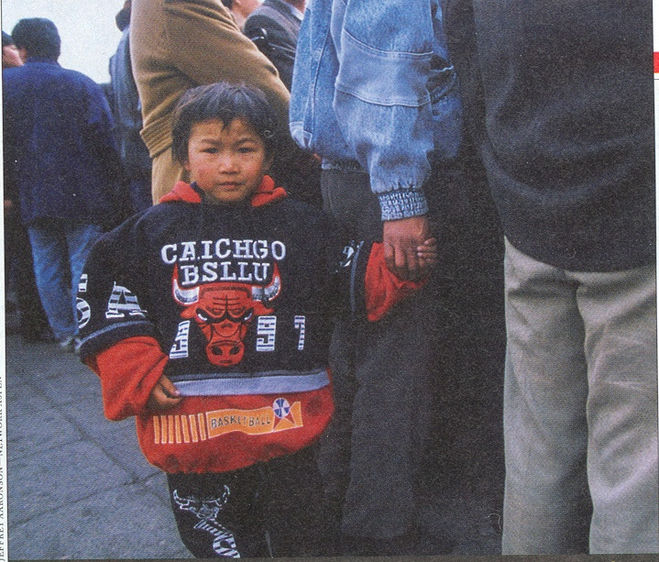

Slide 73
Treating Malaria
Supportive Care
Anti-epileptic medication if needed
Adequate hydration
Plenty of sugar if severe illness
Comfort measures
Preventive Care
Never forget!

Slide 74
Treatment of Uncomplicated Malaria
Artemisinin Combination Therapy
Artesunate
50 mg pill
½ pill if 5-10 kg
1 pill if 10-20 kg
2 pills if 20-40 kg
daily for 3 days
with either amodiaquine, mefloquine, or SP

Slide 75
Treatment of Uncomplicated Malaria
Artemisinin Combination Therapy
Artemether – Lumefantrine (pills 20 mg A, 120 mg L)
1 dose twice daily for 3 days (1st 2 doses 8 hrs apart)
5 - <15 kg 1 tablet per dose
15 - <25 kg 2 tablets per dose
25 - <35 kg 3 tablets per dose
≥35 kg 4 tablets per dose

Slide 76
A family presents for pre-travel advice prior to a trip to Africa.
What should you do about malaria for the children?

Slide 77
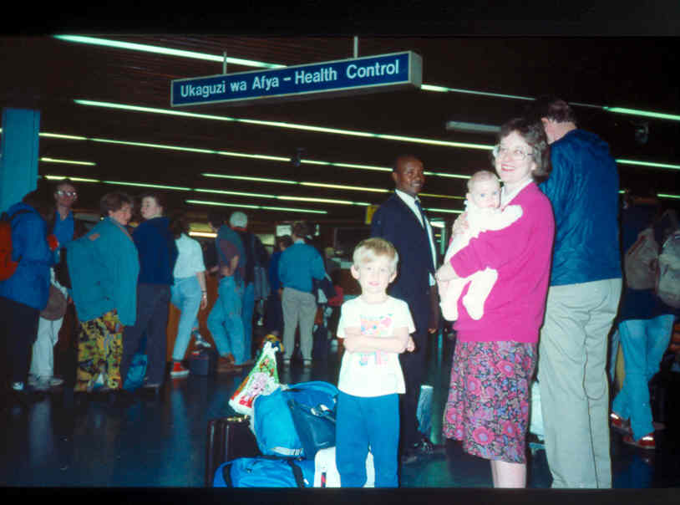

Slide 78
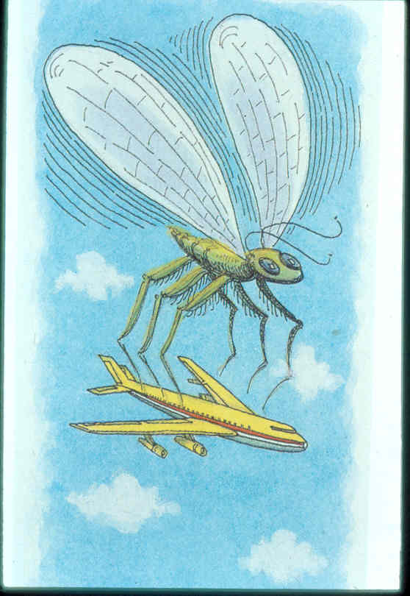

Slide 79
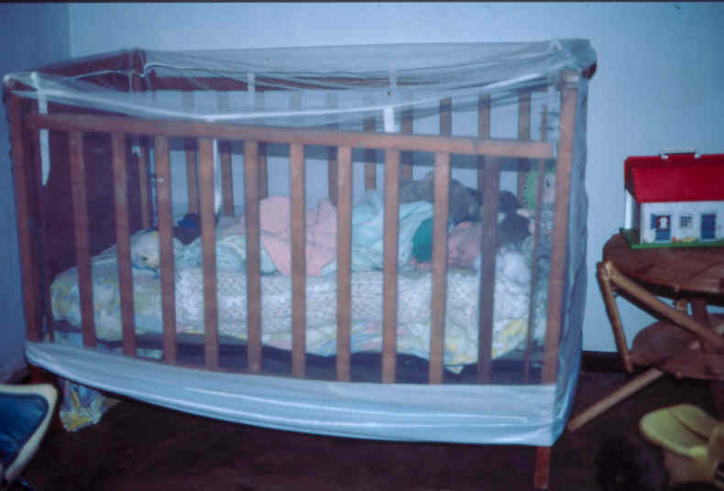

Slide 80
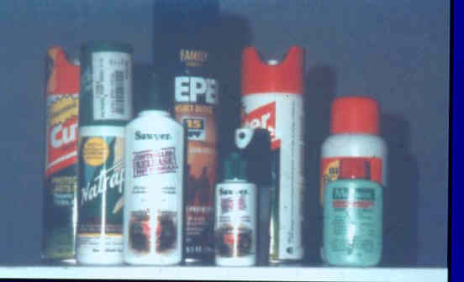

Slide 81
Insect Repellents
Product Duration of Protection
DEET 24% 302 minutes
DEET 20% 234 minutes
DEET 7% 112 minutes
Citronella, 10% 20 minutes
Citronella, 0.05% 3 minutes
Fradin 2002
Picaridin ~ same as DEET

Slide 82
Malaria Prevention in Travelers
Avoid Insect Bites
DEET safe on kids
Picaridin (Icaridin) works, too
Permethrin safe for kids’ clothes
Control stagnant water
Medication
Mefloquine weekly (18% hassles)
Malarone daily (expensive)
Avoid doxycycline prior to age 8

Slide 83
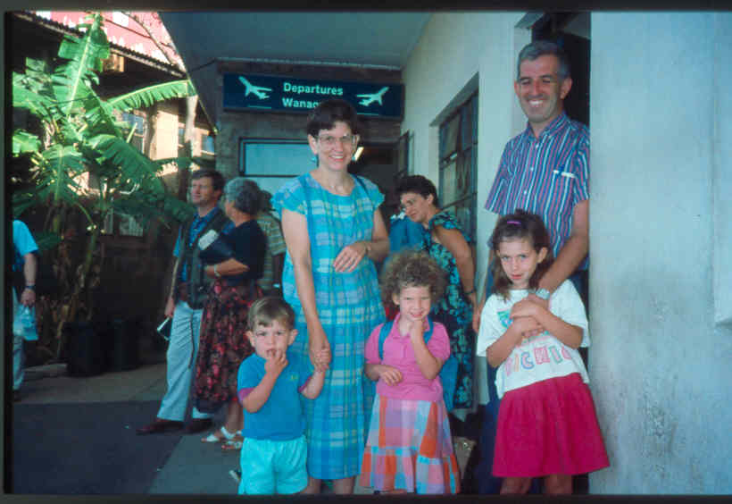

Slide 84
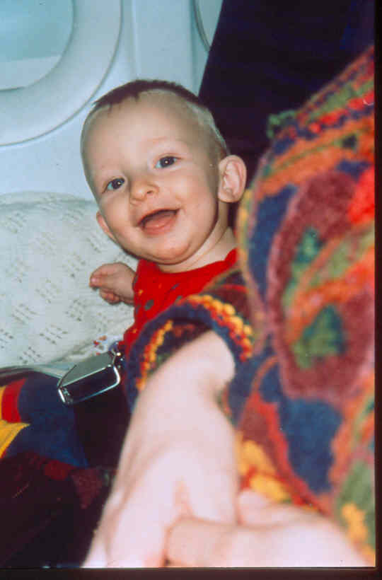

Slide 85
Take-Home Lessons?

Slide 86
Take-Away Lessons?
Malaria is still bad.
Be broad and narrow in diagnostic thinking.
Use artemisinin combination therapy.
Beware of boluses!
Never forget prevention!

Slide 87
fischer.phil@mayo.edu

